Slide 1



Slide 2


My pets
Lesson 2 - Period 4
16

Slide 3
1
2
3
Warm-up and review
4
5
Fun corner and wrap-up
Listen and number.
Look, complete and read.
Let’s play.

Slide 4
1
Warm-up and review

Slide 5

Let’s sing together!
Notes:
https://www.youtube.com/watch?v=pWepfJ-8XU0

Slide 6
2
Listen and number.

Slide 7

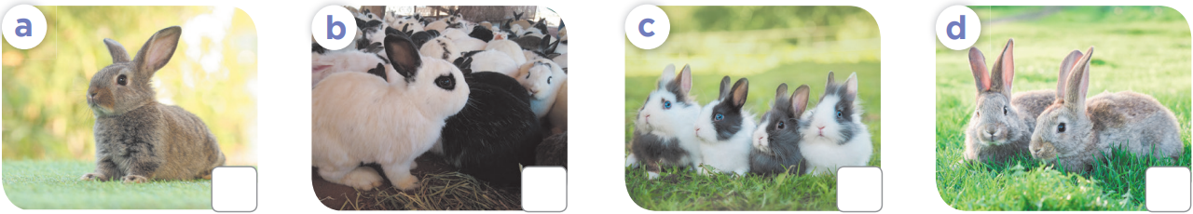
4
1
2
3

Slide 8
3
Look, complete and read.

Slide 9
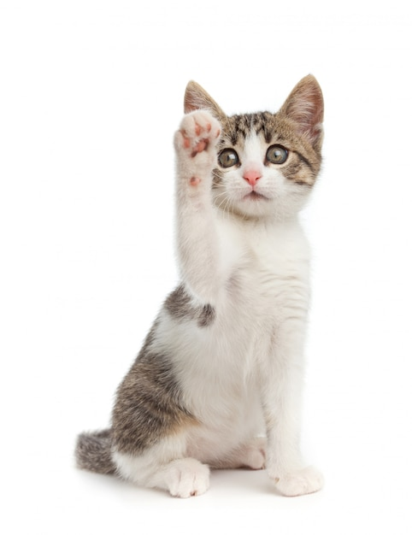







How many ……….. do you have?
cat
a cat
cats

Slide 10
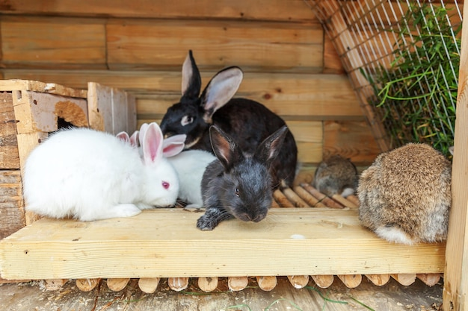
……………… many rabbits do you have?
How
What
Who

Slide 11
How many cats do you have?
I have one cat.
I have some cats.
I have many cats.

Slide 12
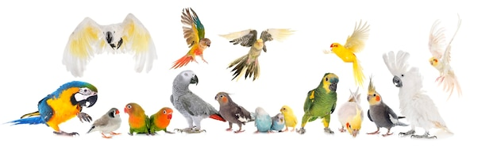
How many parrots do you have?
I have one parrot.
I have some parrots.
I have many parrots.

Slide 13
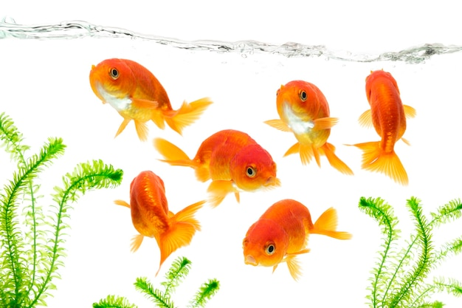
How many fish do you have?
I have one fish.
I have some fish.
I have many fish.

Slide 14
Open your book!

Slide 15
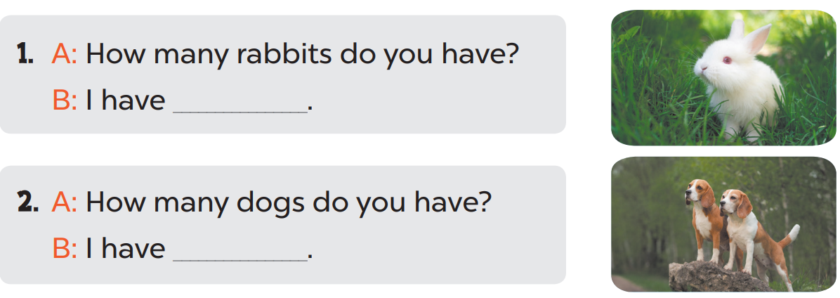
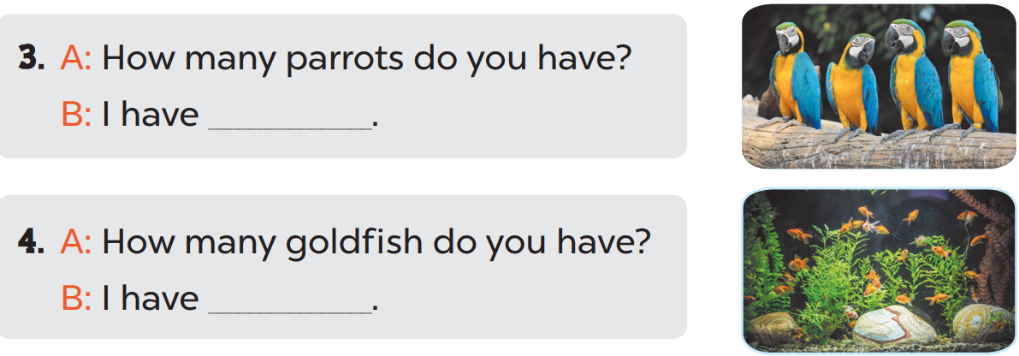
one
two
some
many

Slide 16
4
Let’s play.

Slide 17
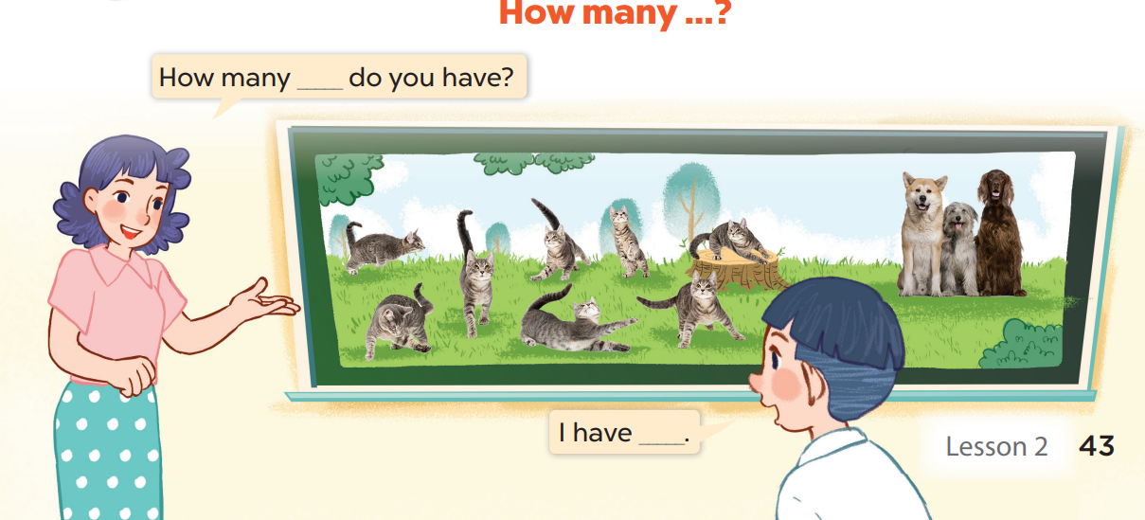

Slide 18
5
Fun corner and wrap-up

Slide 19


5
10
1
7
8
SPIN
-5
3
9
-3
4
6
2
tekhnologic
Notes:
- Divide the class into teams.
- Teacher calls one pupil to answer the question. (Invite 2 pupils from each team to ask and answer about pets, using the model sentences they have learnt in this lesson.)
- Pupils/ teachers click on the “spin” button to get points.

Slide 20

Website: sachmem.vn
Fanpage: www.facebook.com/sachmem.vn

